Slide 1
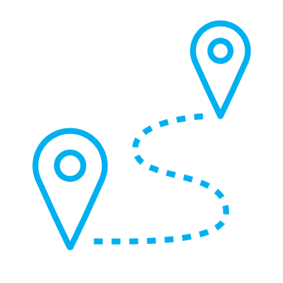
Kubernetes for GPS Tracking System
IOT-STORAGE & VIRTUALIZATION
Prof. Alireza Rahmani Niaraki
Daniel Ruiz
Maria Gonzalez

Slide 2
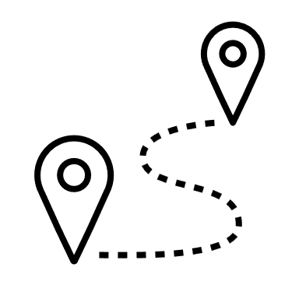

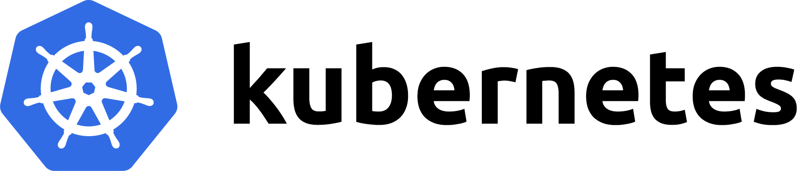
Project Scope
GOALS
Practice the use of and concepts in a potential real case scenario.
Reflect on the use of to acquire a deeper understanding of the tool and the problems it solves.
LIMITS
Probably not the optimal way of using components.
Deeper understanding of components and k8s arquitecture is needed.

Slide 3

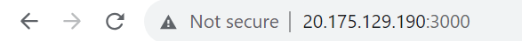
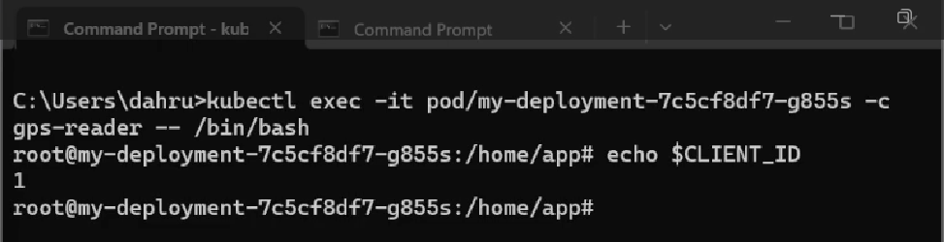

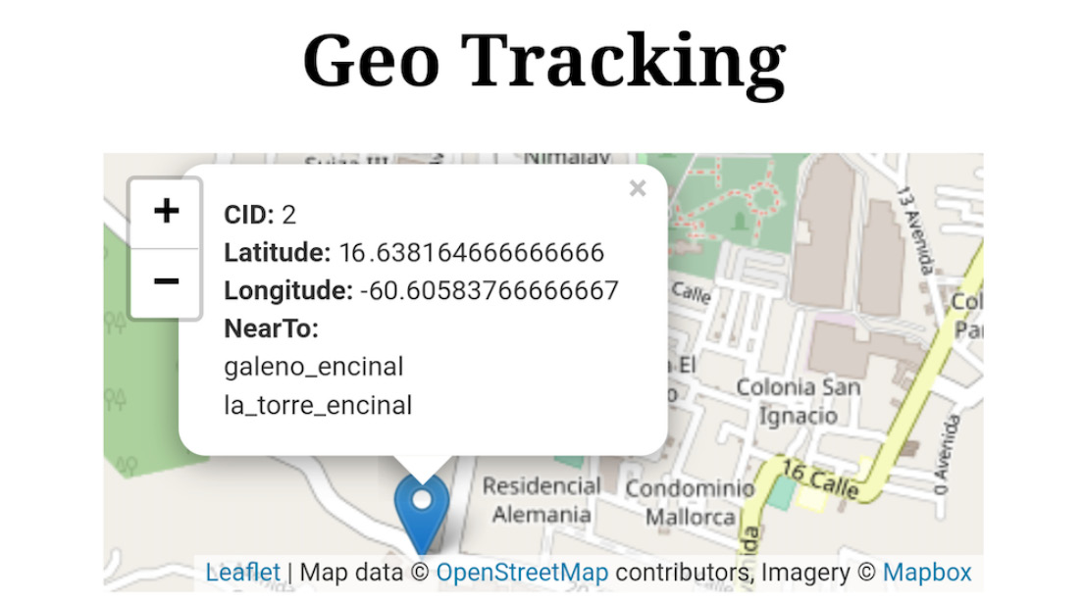
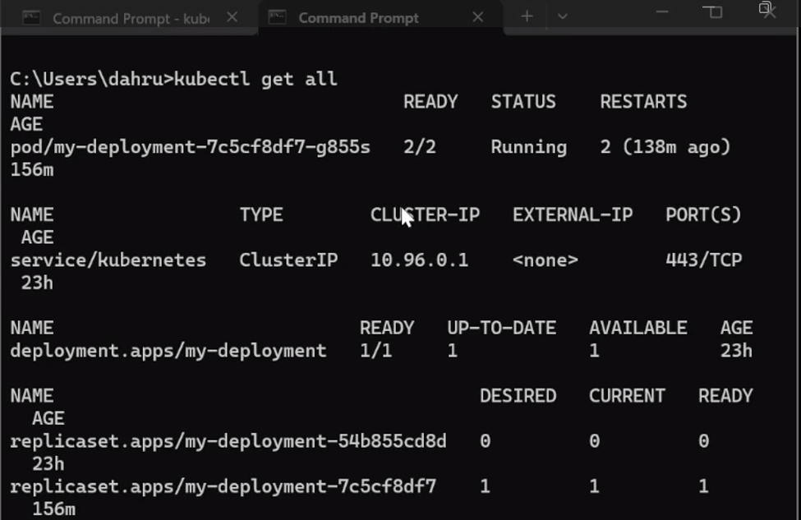
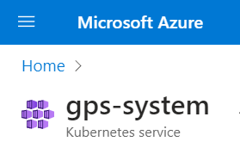
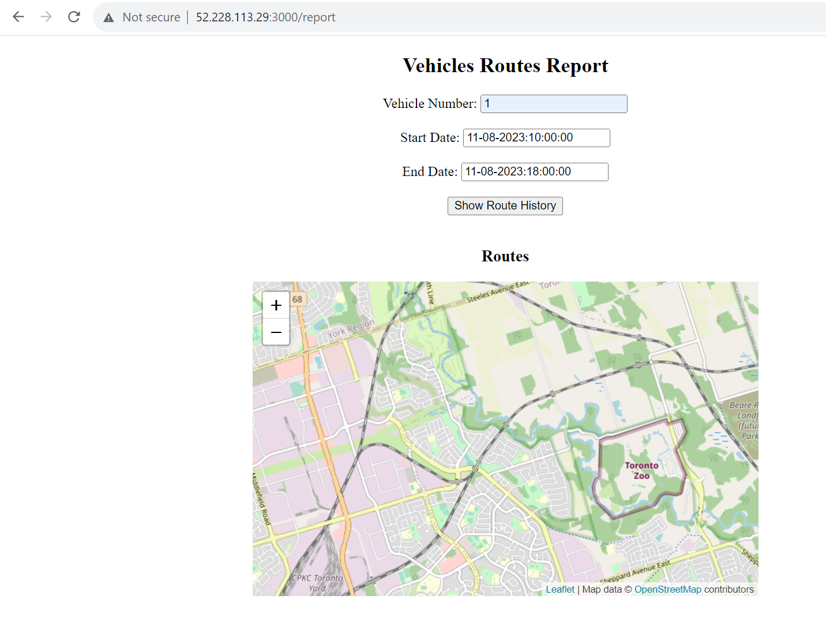
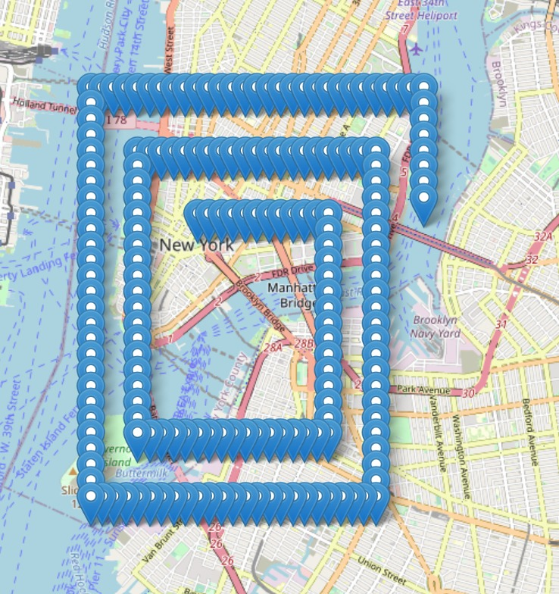
Demo
Daniel’s
CID 1
Maria’s
CID 2

Slide 4
Kubernetes GPS Tracking System Architecture
Cloud layer
Edge layer
K8s cluster Node
minikube cluster Node
Internet
2 replica
Redis
Pod (1 replica)
2 replica
gps-server
Service: lb
POST req.
gps-writer
gps-reader
Service: lb
frontend
tracking- server
Volume
Mongo db
2 replica
2 replica
The gps-writer and gps-reader containers are closely linked, favoring placement within the same pod. No data persistence or Service component is necessary in this context.
We are using wifi, but real system should use the LTE network, for example.
Mongo db should use a persistent volume.

Slide 5
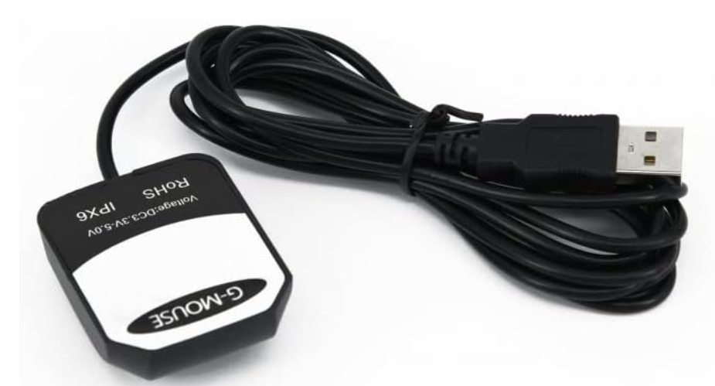
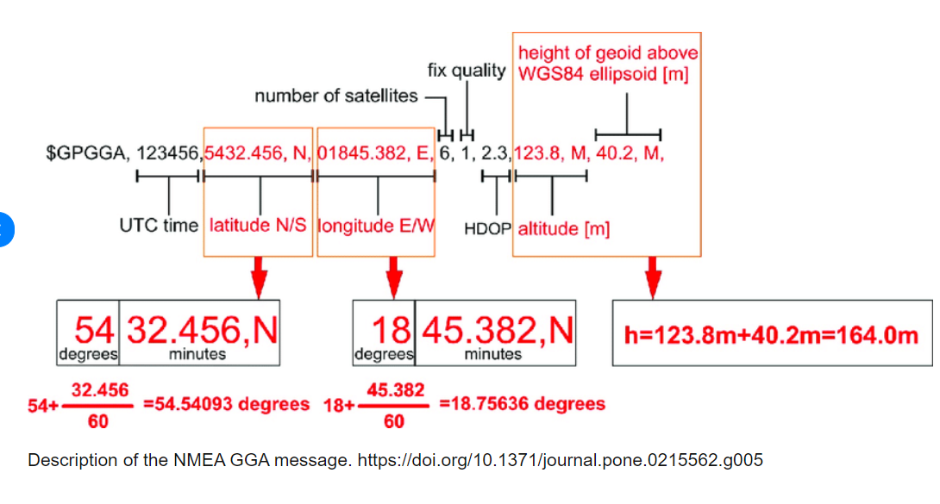
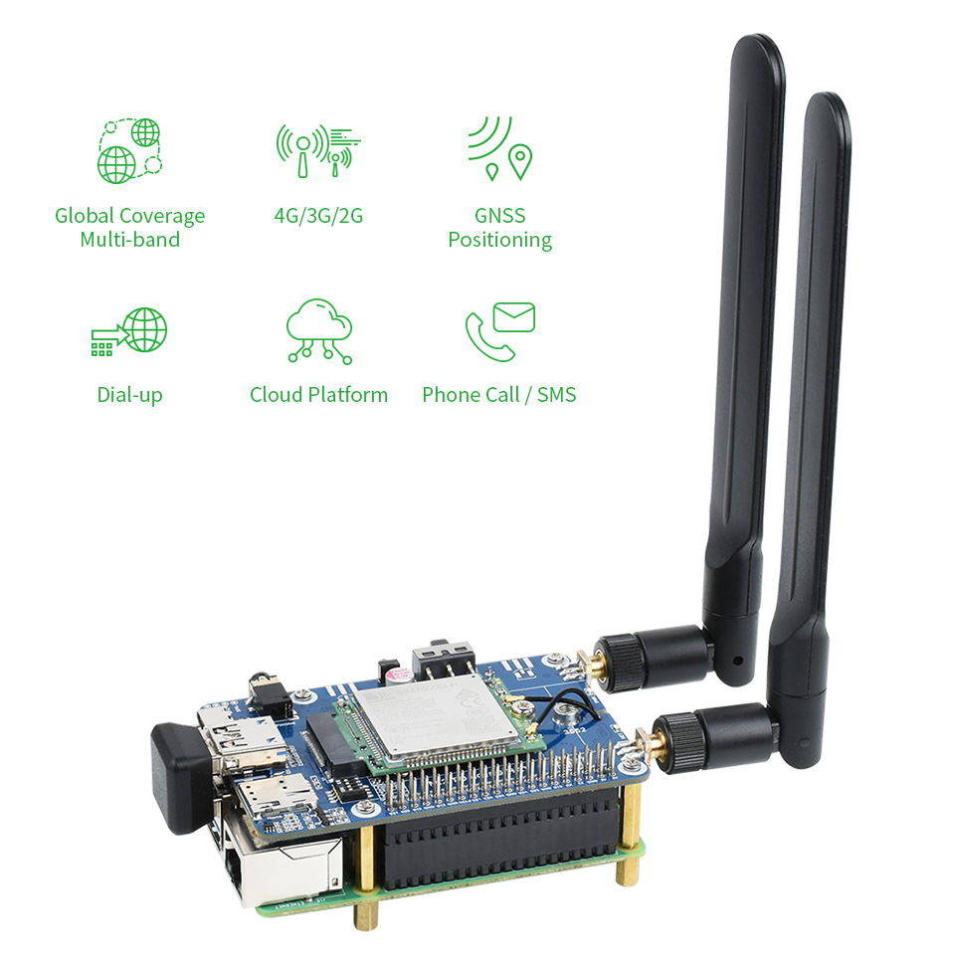
Edge Cluster
In a practical use case, the gps-reader would read from a GPS module and convert coordinates from NMEA format to decimal degrees.
"$GPGGA,123519,4807.038,N,01131.000,E" →
{“latitude”: 48.1173, “longitude”: 11.5167}

Slide 6
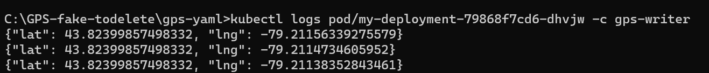
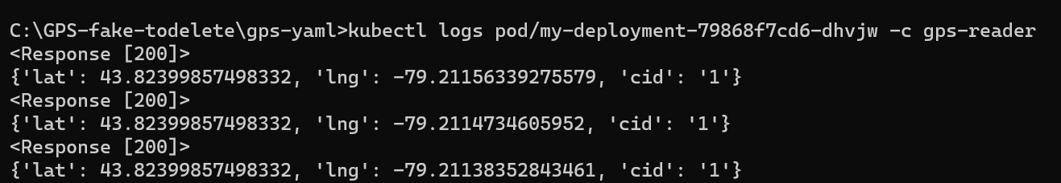















Edge Cluster
Computation happening in the edge.
generating artificial coordinates in decimal degrees format (gps-writer).
appending carID (gps-reader).

Slide 7
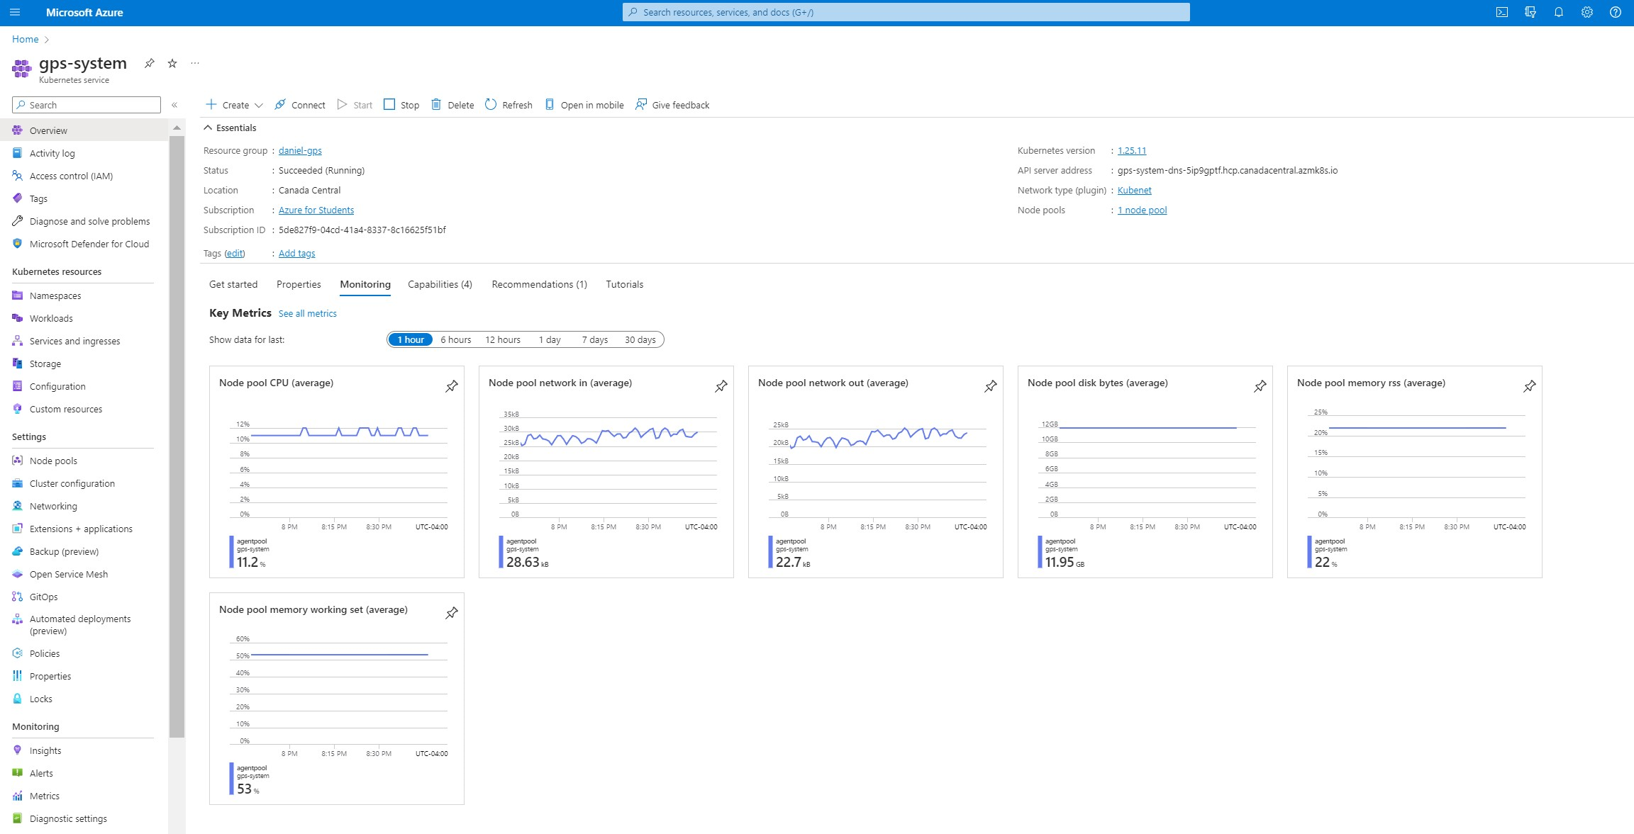
Cloud Cluster

Slide 8
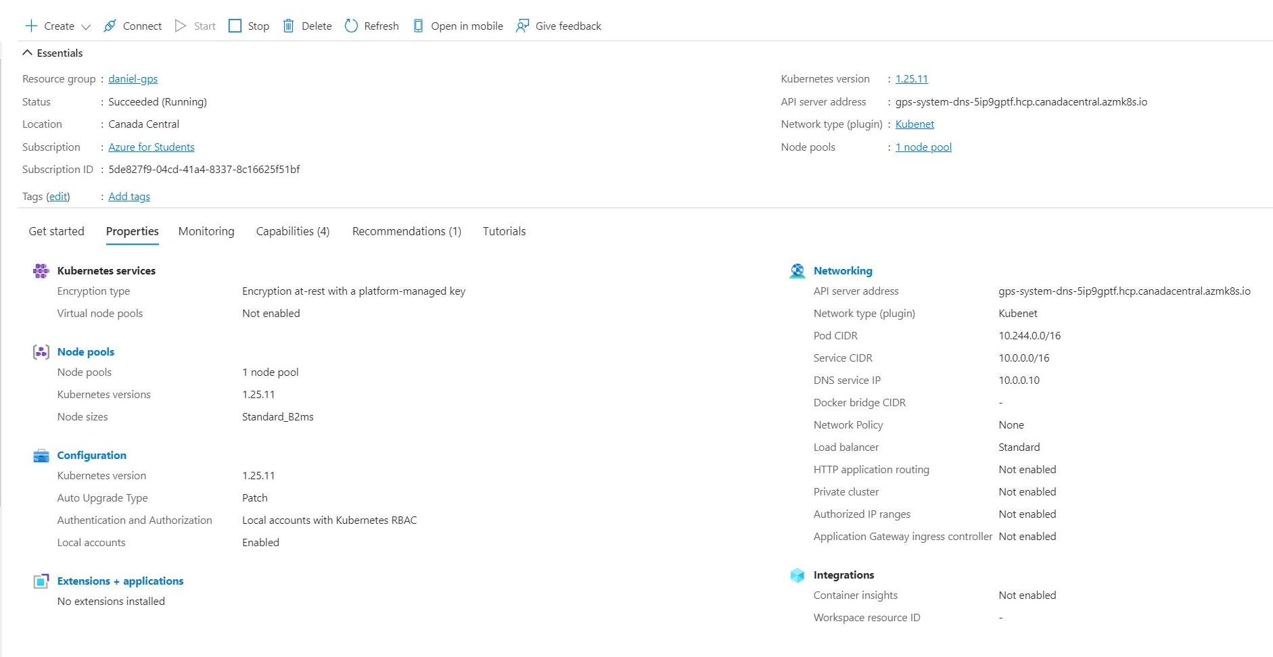
Cloud Cluster

Slide 9
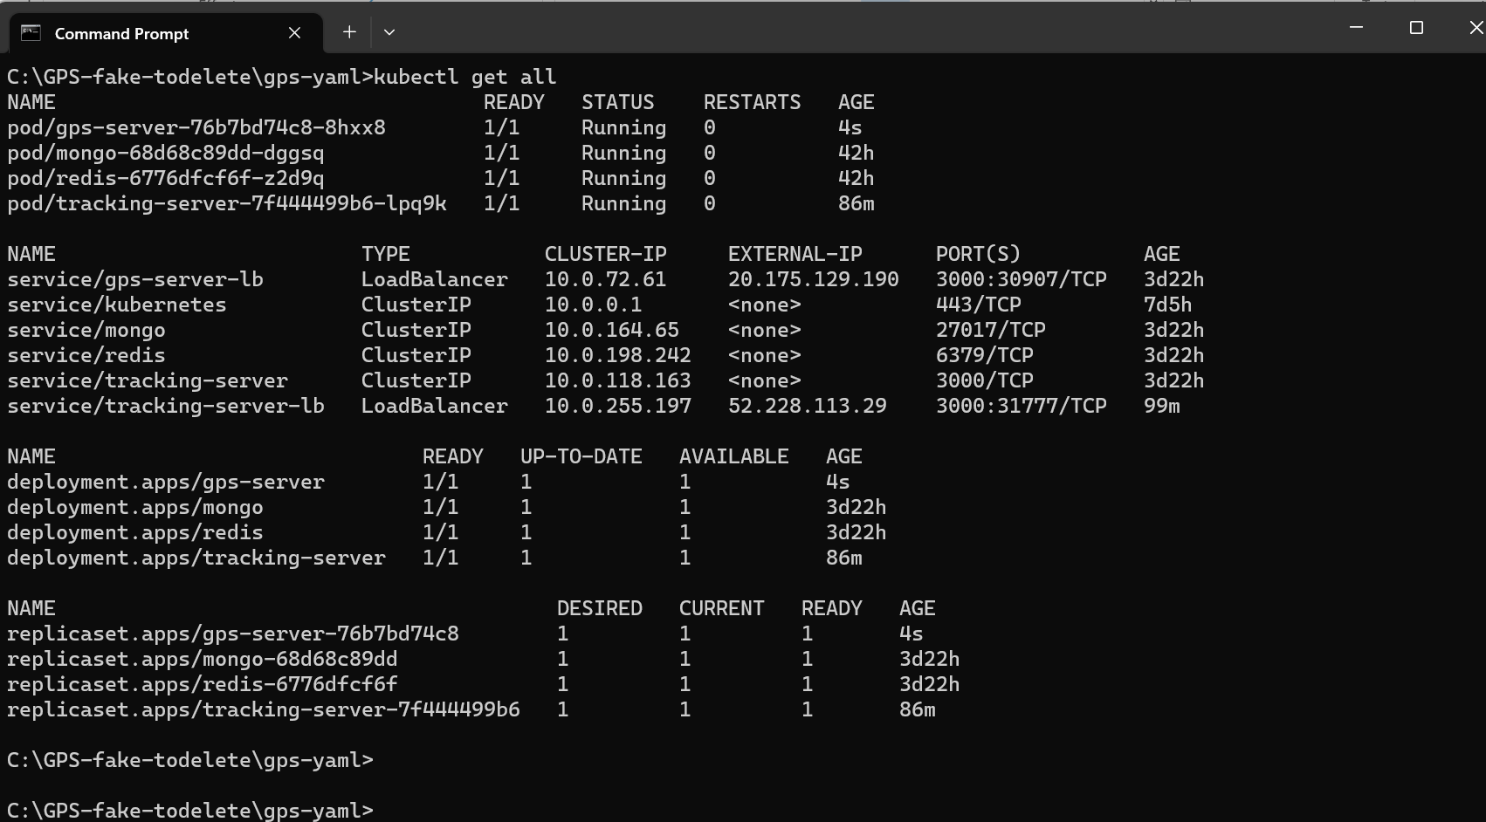
Cloud Cluster

Slide 10
References
Méndez, S. (2022). Edge Computing Systems with Kubernetes. Packt Publishing.
Kubernetes Documentation. (2023, August 01). Communicate Between Containers in the Same Pod Using a Shared Volume. https://kubernetes.io/docs/tasks/access-application-cluster/communicate-containers-same-pod-shared-volume/ (Last modified: August 01, 2023, 4:57 PM PST).

